Slide 1
A New Framework for Surveillance System
Weihong Li
Notes:
“Let computer understand what it sees” is a big motivation for computer scientist in computer vision community.
There are a lot of applications based on this research. Surveillance is one of them.

Slide 2
Overview of the System
Locate and track the moving objects
  Background Subtraction
  Salient Motion Detection
  Geodesic Active Contour
Classify the moving objects
  Single Person
  Vehicles
  Group of Persons
Detect the unusual events using HMM
  U-turn detection
Notes:
The system contains 3 main parts: that is, ….
there are some algorithms for tracking the moving objects,
The most intuitive and efficient way is by doing background subtraction.The idea is to subtract the current frame with moving objects from the background frame, this will isolate the front moving objects out. This method is widely adapted in inside tracking, like in room, hallway, etc. However, this method has trouble to deal with the dynamic background, like outside scene, where the tree or bushes are wavered by the wind. Salient motion detection is used as a complemental method to background subtraction. The basic idea is to calculate the optical flow of the frame and cluster the region which has a large value of optical flow.
After obtain the tracked objects, we’ll be able to classify them into categories.
Then, I’ll talk about the unusual events detection by using HMM, for example, the u-turn events.

Slide 3
Overview of the System
Locate and track the moving objects
  Background Subtraction
  Salient Motion Detection
  Geodesic Active Contour
Classify the moving objects
  Single Person
  Vehicles
  Group of Persons
Detect the unusual events using HMM
  U-turn detection
Notes:
The system contains 3 main parts: that is, ….
there are some algorithms for tracking the moving objects,
The most intuitive and efficient way is by doing background subtraction.The idea is to subtract the current frame with moving objects from the background frame, this will isolate the front moving objects out. This method is widely adapted in inside tracking, like in room, hallway, etc. However, this method has trouble to deal with the dynamic background, like outside scene, where the tree or bushes are wavered by the wind. Salient motion detection is used as a complemental method to background subtraction. The basic idea is to calculate the optical flow of the frame and cluster the region which has a large value of optical flow.
After obtain the tracked objects, we’ll be able to classify them into categories.
Then, I’ll talk about the unusual events detection by using HMM, for example, the u-turn events.

Slide 4
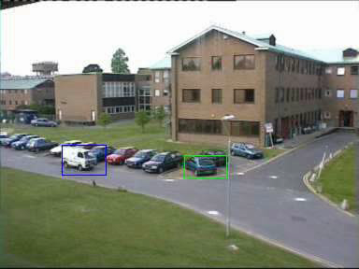
Locating and Tracking
Traditionally, tracking is accomplished by background subtraction, followed by some post-process, like region correspondence.
  Drawback: has no accurate boundary contour.
  http://www.cs.ucf.edu/~vision/projects/Knight/Knight.html
Notes:
As I said, ….

Slide 5
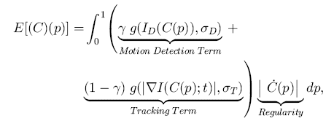
Geodesic Active Contour
Propagating Curves
  Level set theory
  Geodesic Active Contours
  Front propagation Algorithms
Detection and Tracking
  N. Paragios and R. Deriche PAMI “Geodesic Active Contours and Level Sets for the detection and tracking of moving objects”
Notes:
This method involved a bunch of mathematics principle, like level set theory, Geodesic active contours and front propagation alg. Basically, the geodesic active contour model is described by the energy minimization equation with respected to curve length and position.
Here, gamma is a parameter, if gamma is close to 0, the model is forced to detect the moving objects, if the gamma is set to 1, the model is forced to tracking
G is a gaussian function, ID is the motion difference image. DeltaI is gradient, and C is level set function. C. is the partial derivative of curve with respect to its parameter p. p is a real number range from 0 to 1.
If you are interested in this, please refer to the paper for more details.

Slide 6
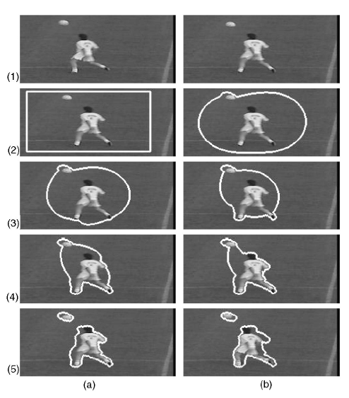
Motion Detection Process
Notes:
In Motion detection phase,
Here we have 2 frames, the previews frame and the current frame. After initialize the curve, the system will try to minimize the curve step by step from left to right, top to bottom.

Slide 7
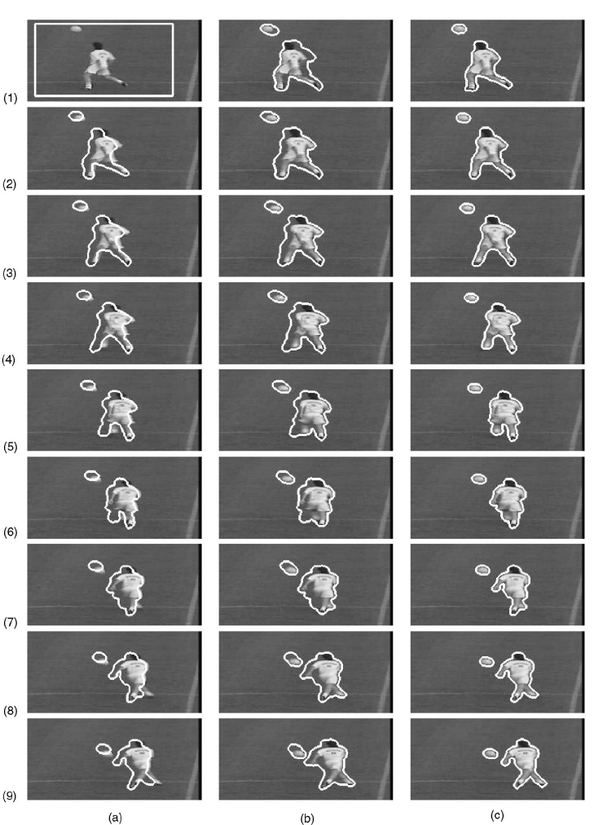
Tracking Process
Notes:
In the tracking phase,
The previews tracked boundary is used as initial curve to the input of the current frame.
The problem is the convergence is slow if we give a large initial curve.
My idea is first apply the background subtraction and salient motion detection to get the initial contour and then, using Geodesic Active Contour to get much better tracking contour.

Slide 8
Overview of the System
Locate and track the moving objects
  Background Subtraction
  Salient Motion Detection
  Geodesic Active Contour
Classify the moving objects
  Single Person
  Vehicles
  Group of Persons
Detect the unusual events using HMM
  U-turn detection
Notes:
The system contains 3 main parts: that is, ….
there are some algorithms for tracking the moving objects,
The most intuitive and efficient way is by doing background subtraction.The idea is to subtract the current frame with moving objects from the background frame, this will isolate the front moving objects out. This method is widely adapted in inside tracking, like in room, hallway, etc. However, this method has trouble to deal with the dynamic background, like outside scene, where the tree or bushes are wavered by the wind. Salient motion detection is used as a complemental method to background subtraction. The basic idea is to calculate the optical flow of the frame and cluster the region which has a large value of optical flow.
After obtain the tracked objects, we’ll be able to classify them into categories.
Then, I’ll talk about the unusual events detection by using HMM, for example, the u-turn events.

Slide 9
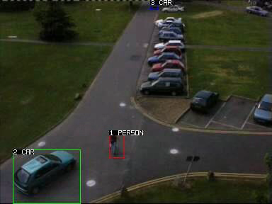
Moving Objects Classification
Based on the recurrence of the motion, the objects can be classified into single person, vehicle and group of persons.
  http://www.cs.ucf.edu/~vision/projects/Knight/Knight.html
Notes:
So, our goal is to get the better boundary of the moving objects and classify them into appropriate categories.

Slide 10
Overview of the System
Locate and track the moving objects
  Background Subtraction
  Salient Motion Detection
  Geodesic Active Contour
Classify the moving objects
  Single Person
  Vehicles
  Group of Persons
Detect the unusual events using HMM
  U-turn detection
Notes:
The system contains 3 main parts: that is, ….
there are some algorithms for tracking the moving objects,
The most intuitive and efficient way is by doing background subtraction.The idea is to subtract the current frame with moving objects from the background frame, this will isolate the front moving objects out. This method is widely adapted in inside tracking, like in room, hallway, etc. However, this method has trouble to deal with the dynamic background, like outside scene, where the tree or bushes are wavered by the wind. Salient motion detection is used as a complemental method to background subtraction. The basic idea is to calculate the optical flow of the frame and cluster the region which has a large value of optical flow.
After obtain the tracked objects, we’ll be able to classify them into categories.
Then, I’ll talk about the unusual events detection by using HMM, for example, the u-turn events.

Slide 11
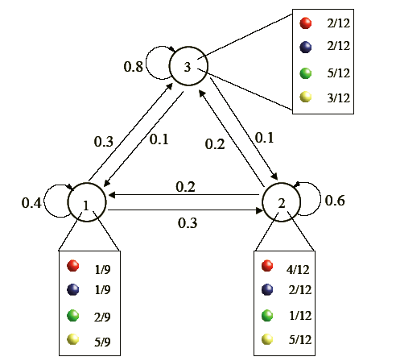
Hidden Markov Model
Definition of the states (hidden)
Definition of the symbols emitted by each state (observed)
State transition probability matrix
Emission probabilities for each state
Vector of initial probabilities
(to select the first state)
    Refer to classical tutorial on HMM:
    L. R. Rabiner – “A tutorial on Hidden Markov
    Models and Selected Applications in Speech
    Recognition”
Notes:
The framework of HMM consists of the following elements:
Hidden states, and the symbols emitted by each state (observed symbol). for example, we have 3 box, which are corresponding to hidden states, and each box has red, blue, green and yellow balls. Suppose you are gonna to pick up balls from the a randomly chosen box, and then pick up the 2nd ball from a box chosen according to transition probability based on the previews box.
One of the tasks of using HMM is to recover the hidden states, given the model and observed symbols. E.g., If we know the color sequence of the balls taken out from the boxes is Yellow, Green, Red, Blue, can you tell me which boxes have I taken? This could be solved by viterbi algorithm using dynamic programming.
If you are interested in HMM, please refer to a classical tutorial on HMM, written by Dr. Rabiner

Slide 12
Events Detection using HMM
A sample model for unusual event detection (U-turn)
Using Viterbi algorithm to perform recognition by computing the maximum log-likelihood value. If the log-likelihood value is lower than a threshold, it is considered a unusual event.
Appear
Straight
Ahead
Dis-
appear
Notes:
The observed output is the trajectory of the moving targets. E.g., the trajectory of the vehicles or persons.
Since we have know the category of the moving objects, we can apply different HMM to different category.

Slide 13
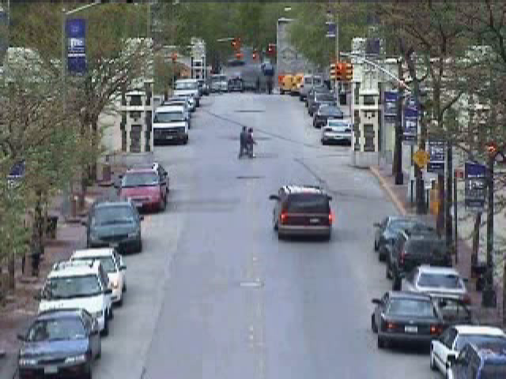
A Demo of the Event
U-turn Video Clip

Slide 14
Thank you!

